Slide 1


Multivariate statistical analysis project
Analysis of credit card user
Wu Yue , Yang Letian , Wang Ruofan

Slide 2

Analysis of credit card user
Data preprocessing
Customer Segmentation
Credit Limit Analysis

Slide 3

01
Data Preprocessing

Slide 4
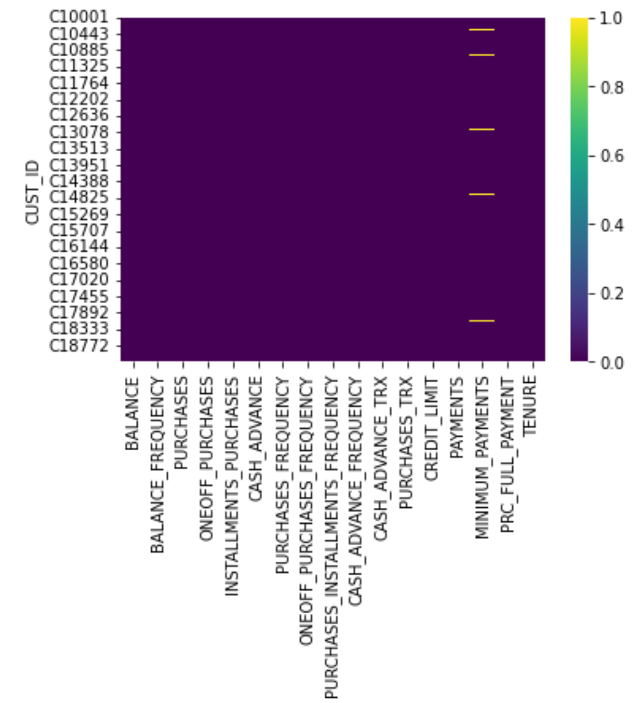

Data Preprocessing
Missing Value

Slide 5
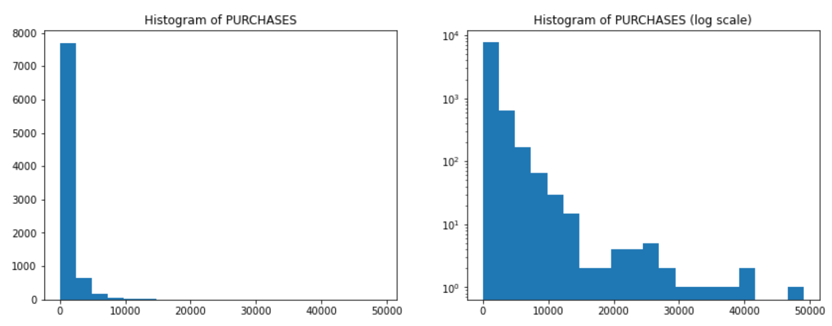
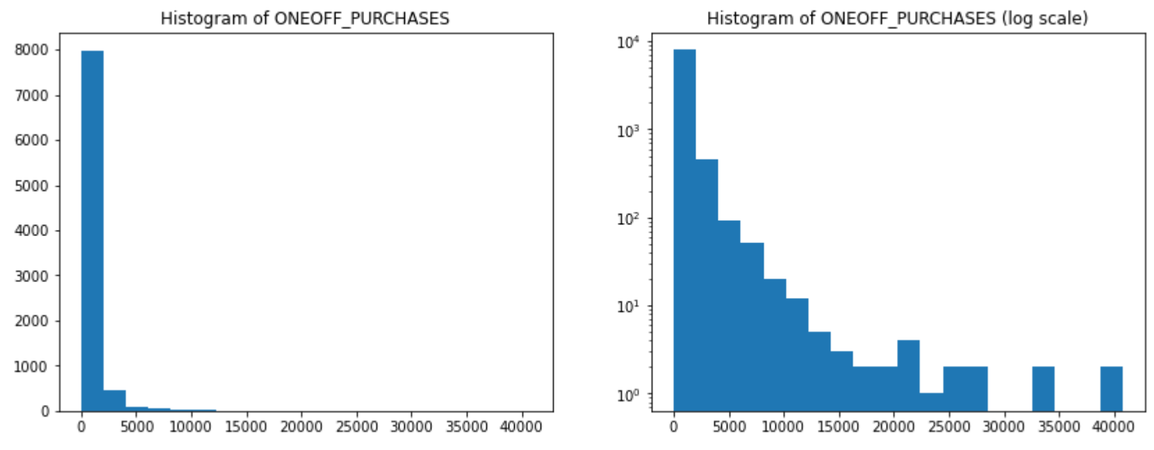
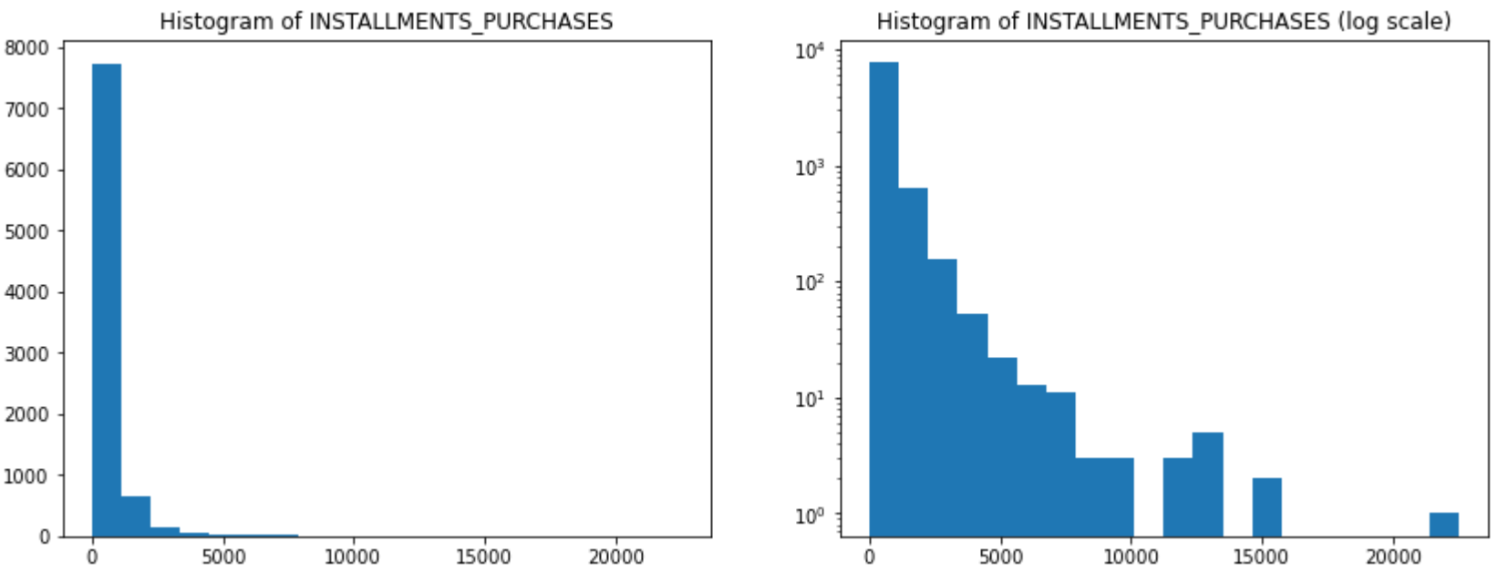
Data Preprocessing
Purchases = oneoff_purchases + installments_ purchases
前三个有关系
并且因此筛选掉了部分数据
Unusual values

Slide 6
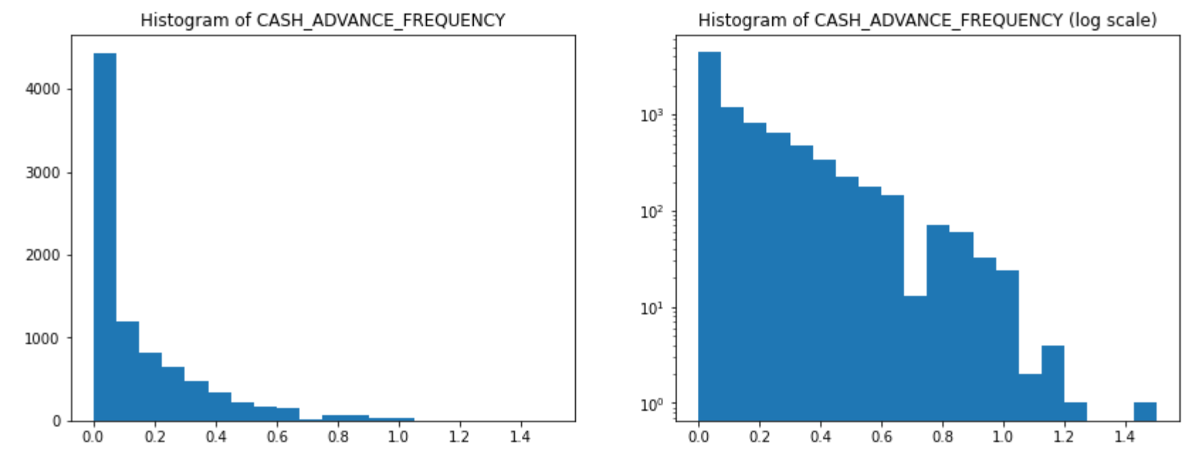
Data Preprocessing
删去异常值： sum>1

Slide 7
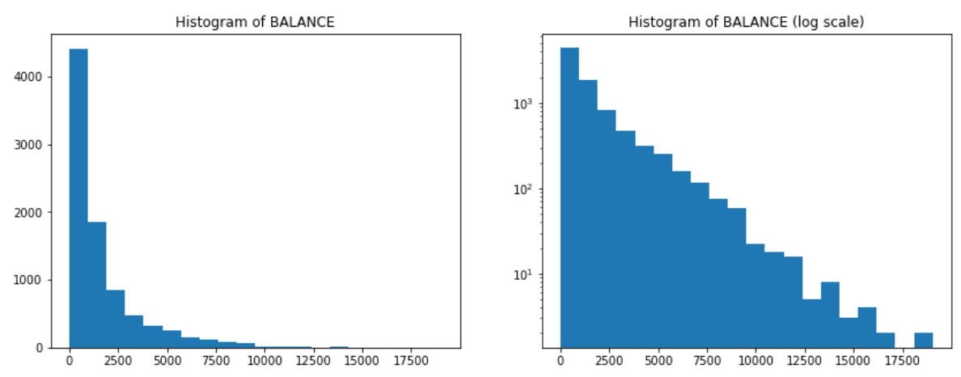
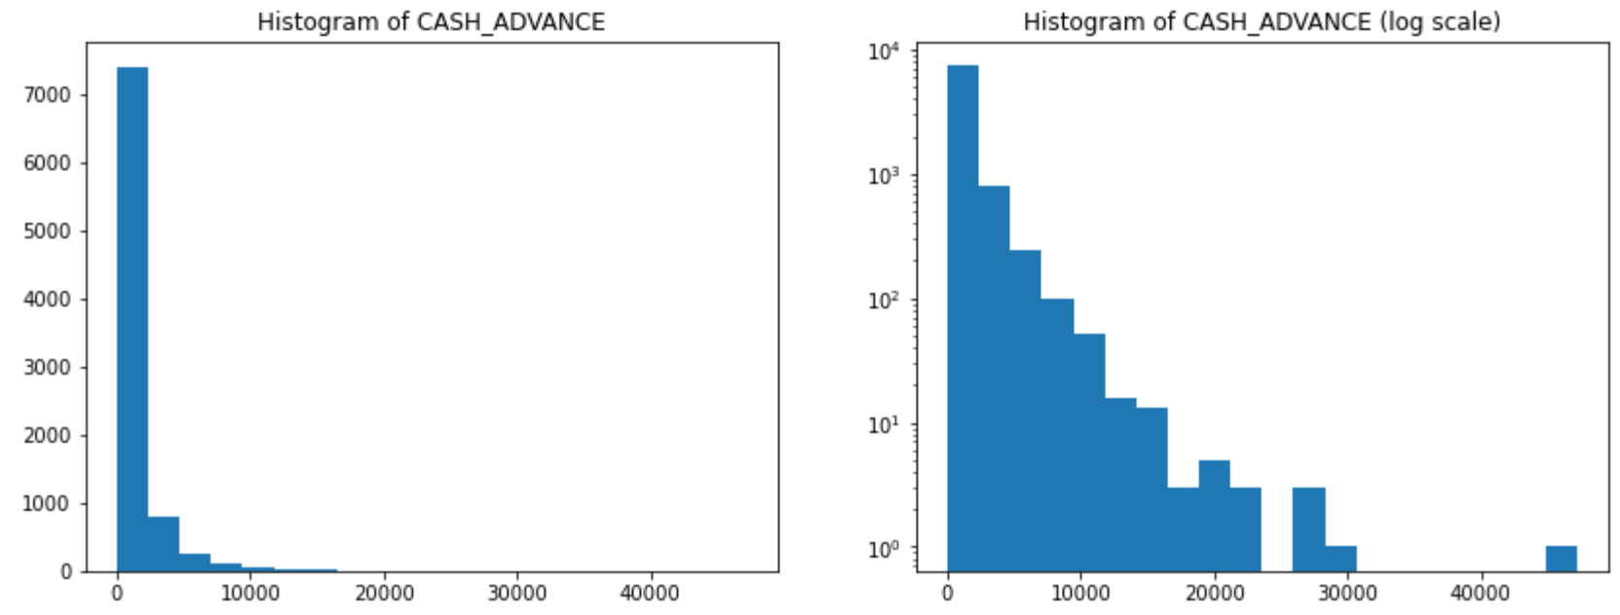
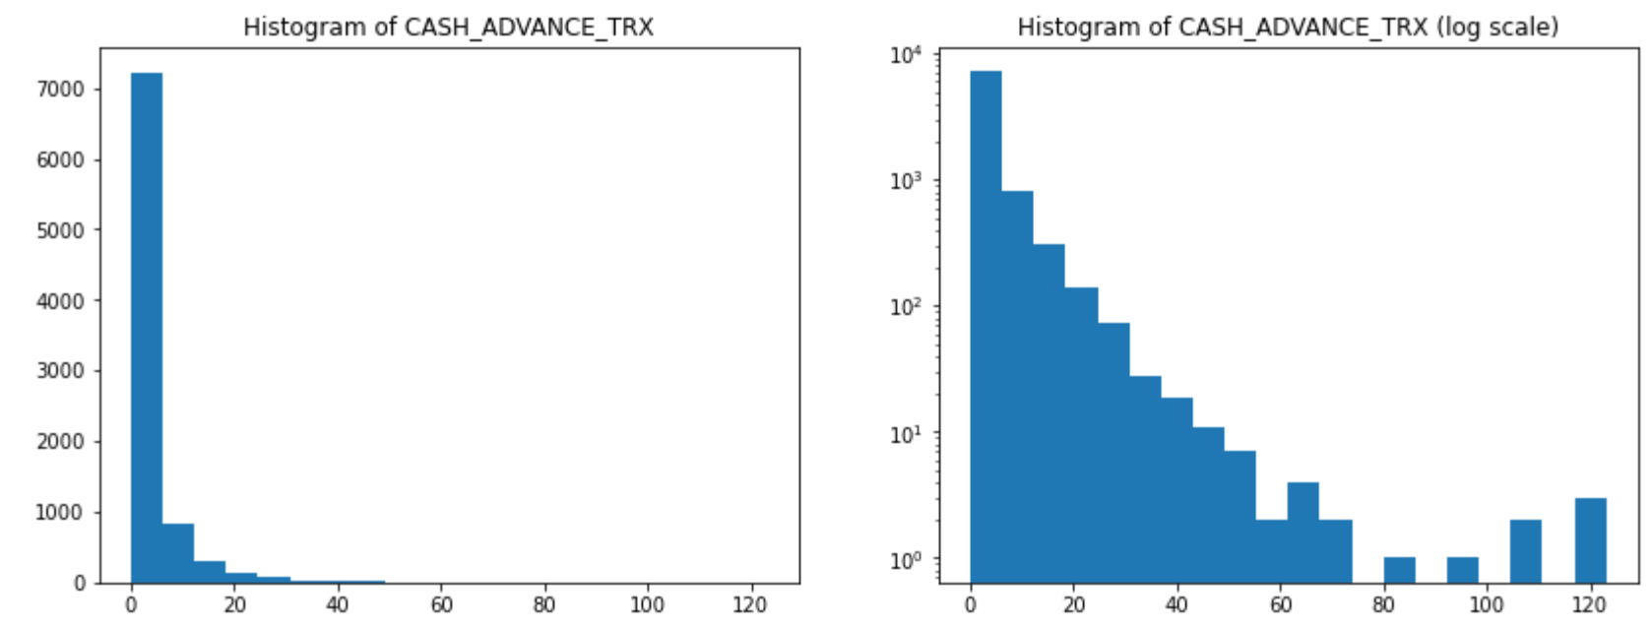
Data Preprocessing
Right skewed data

Slide 8
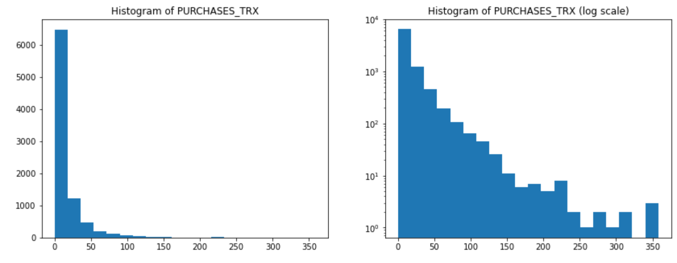
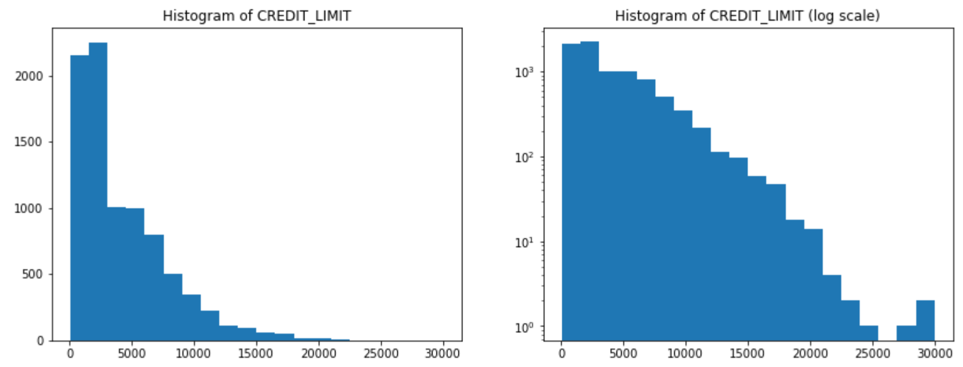
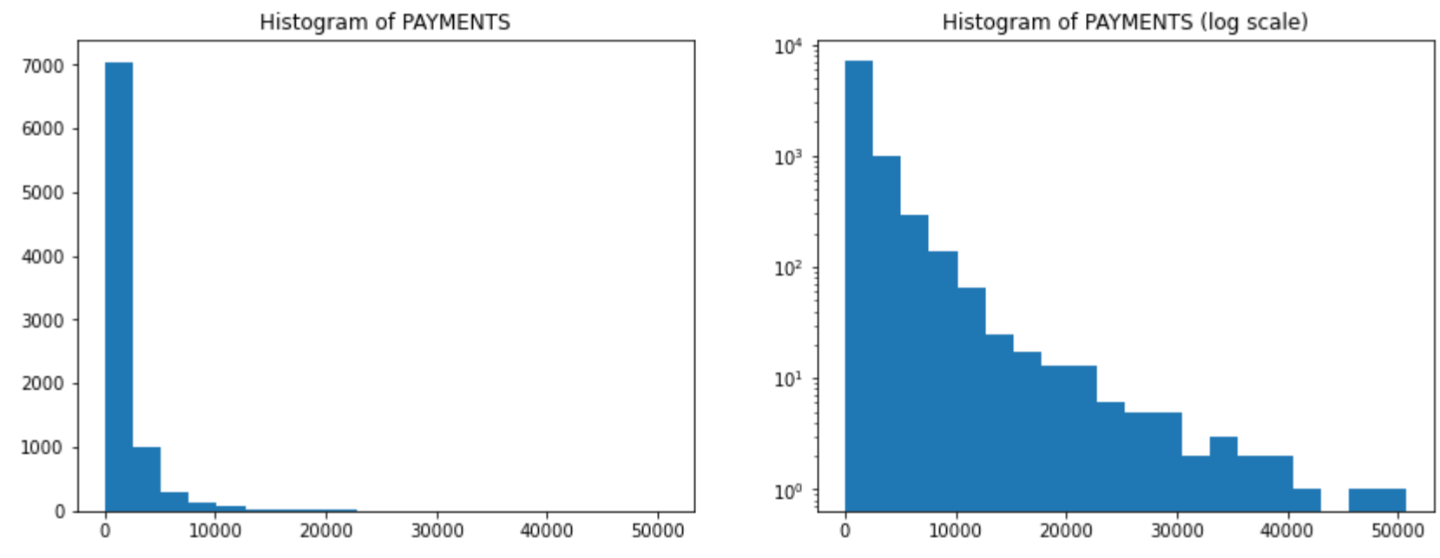
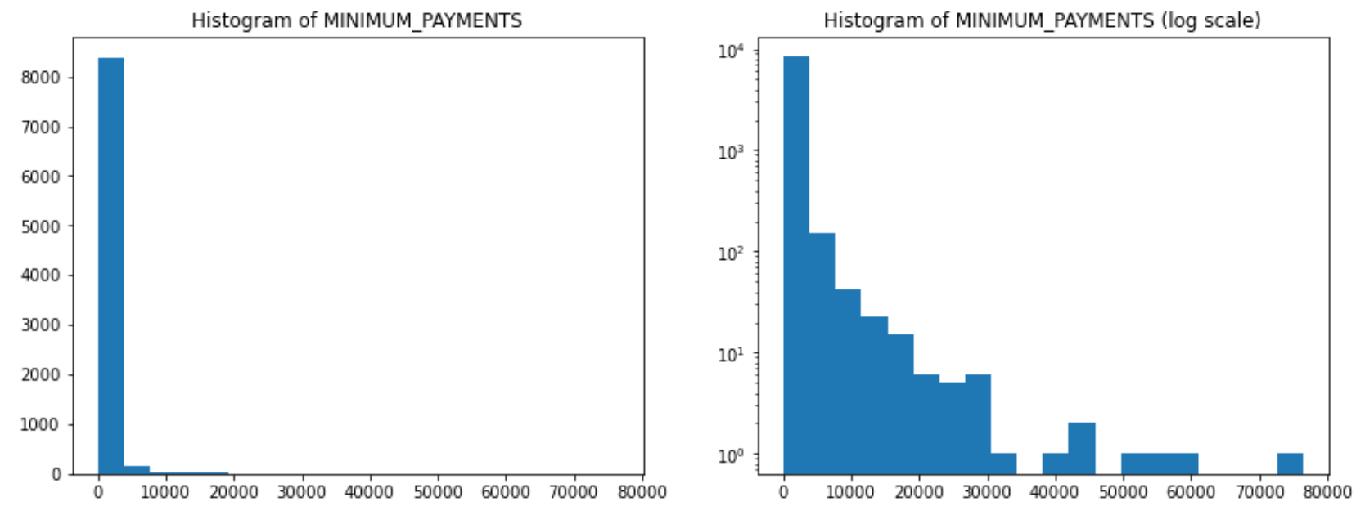
Data Preprocessing
Right skewed data

Slide 9
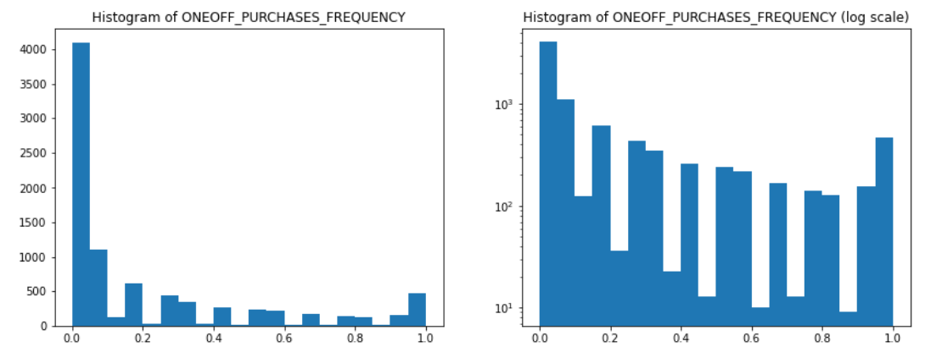
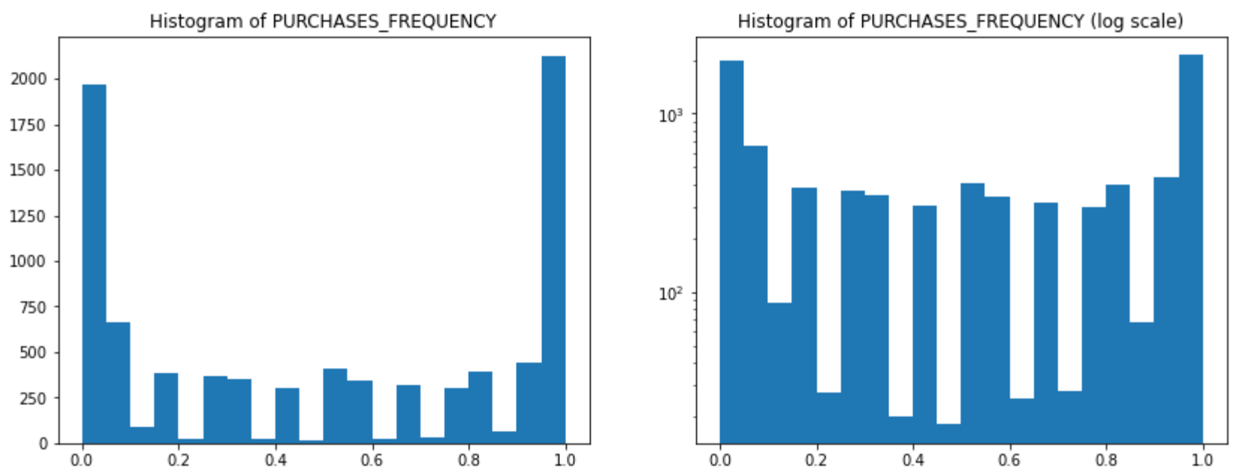
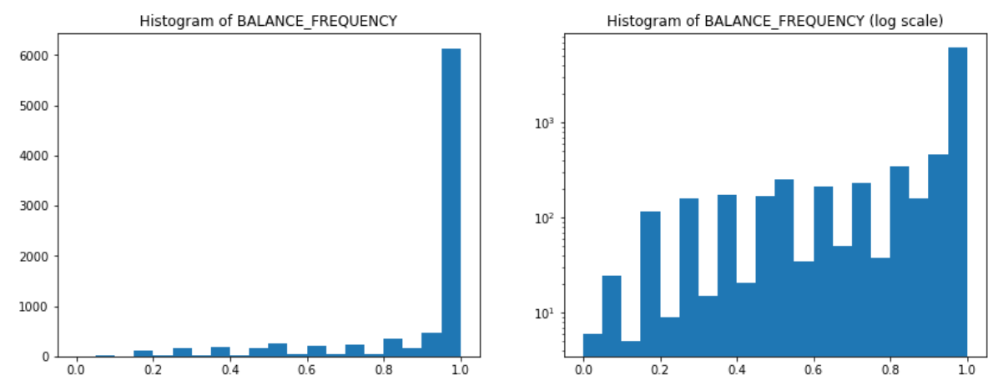
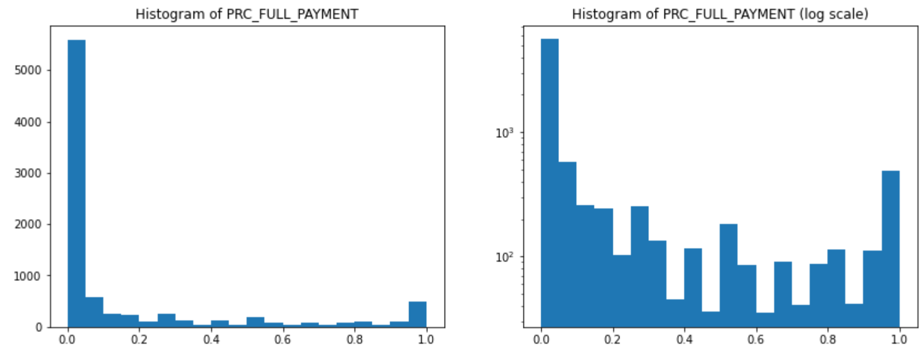
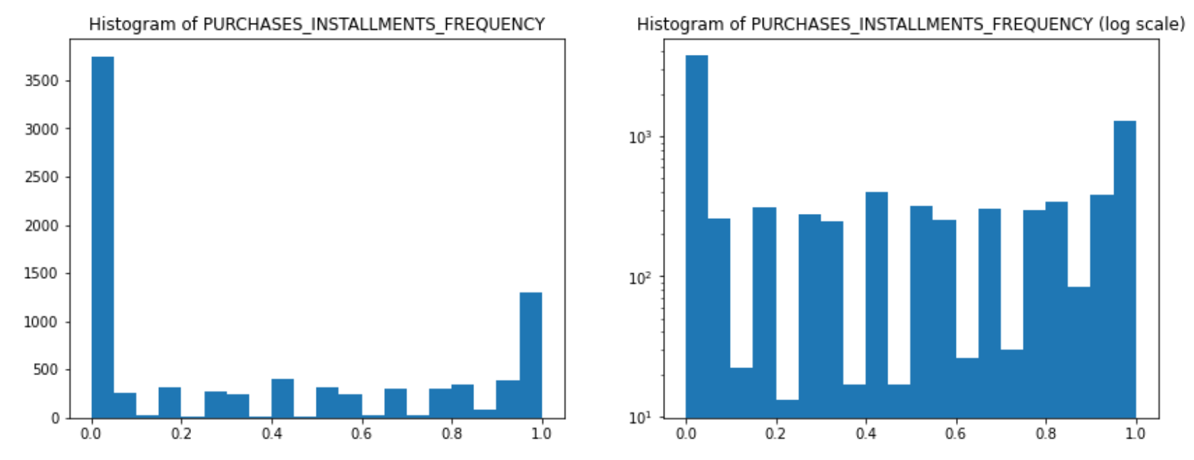
Data Preprocessing
Frequency data

Slide 10
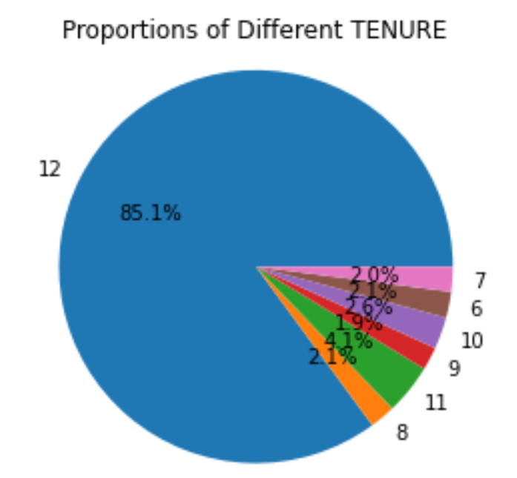
Data Preprocessing
Categorical data

Slide 11
02
Customer Segmentation

Slide 12
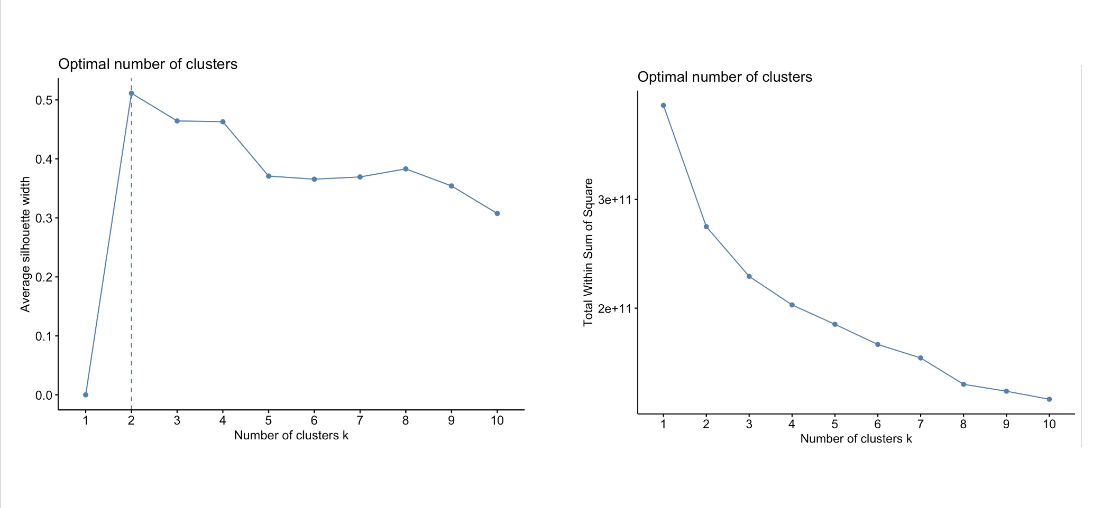
Customer Segmentation
Determine Optimal Clusters number:

Slide 13
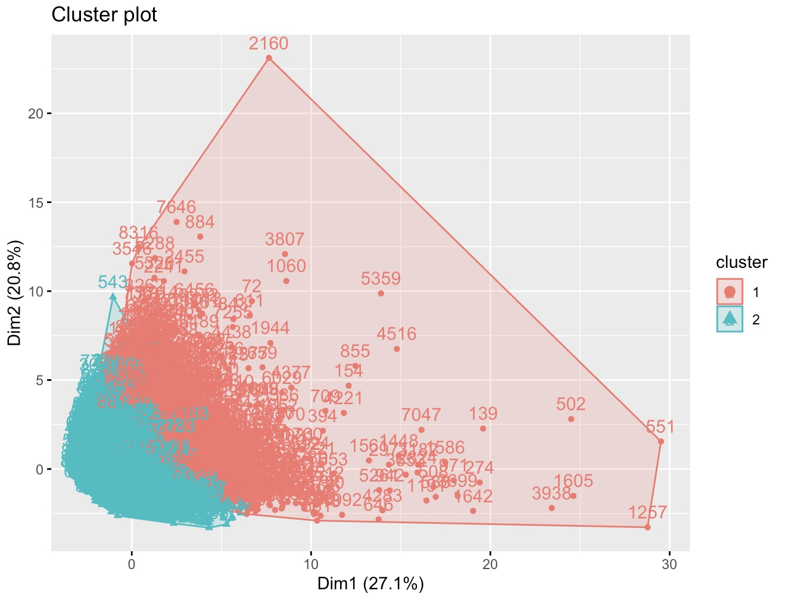
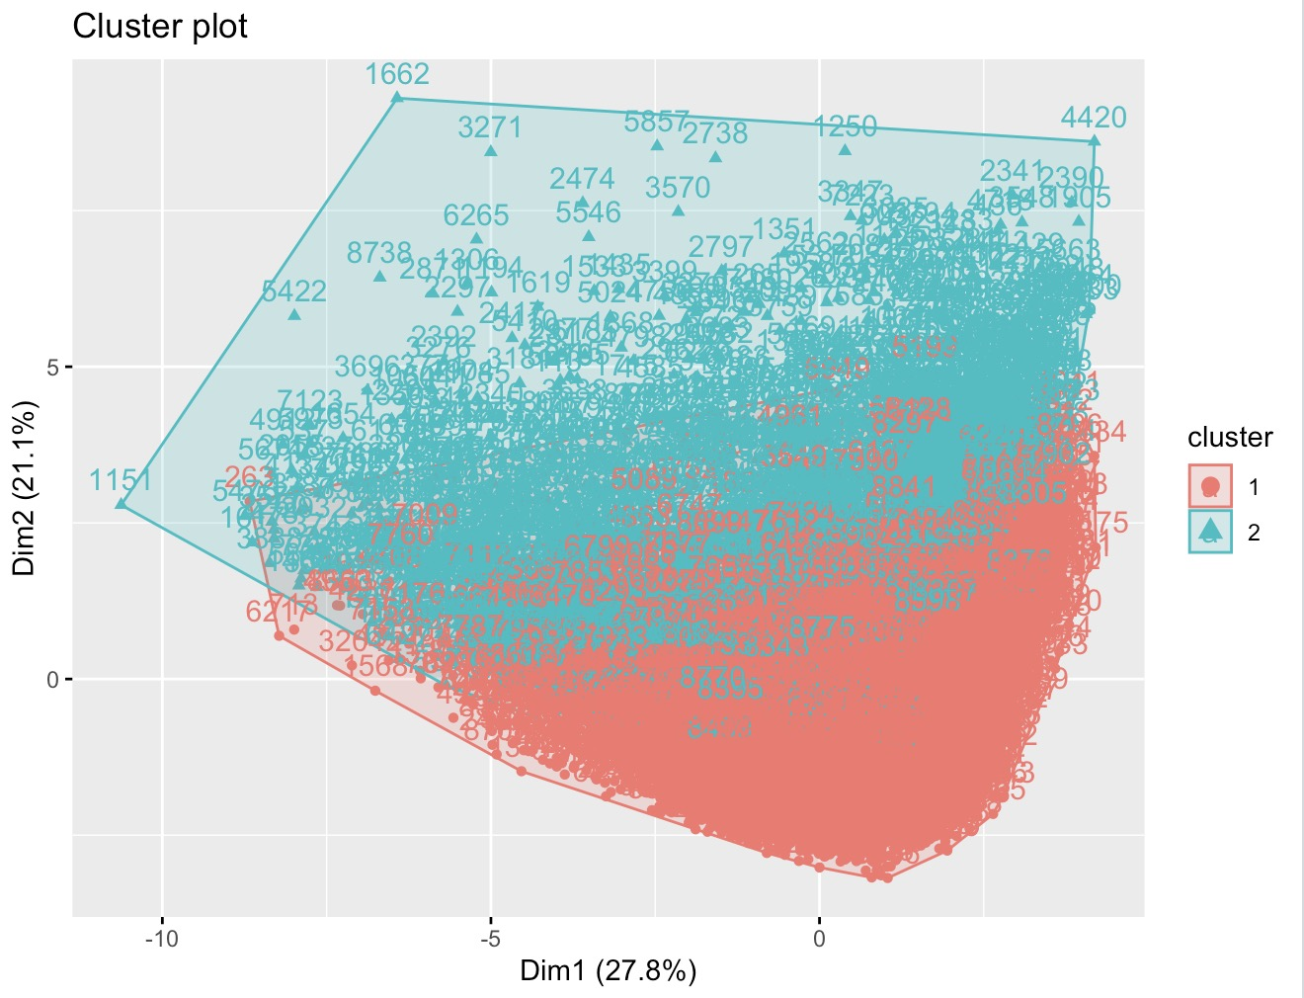
Customer Segmentation
Removing Outliers

Slide 14
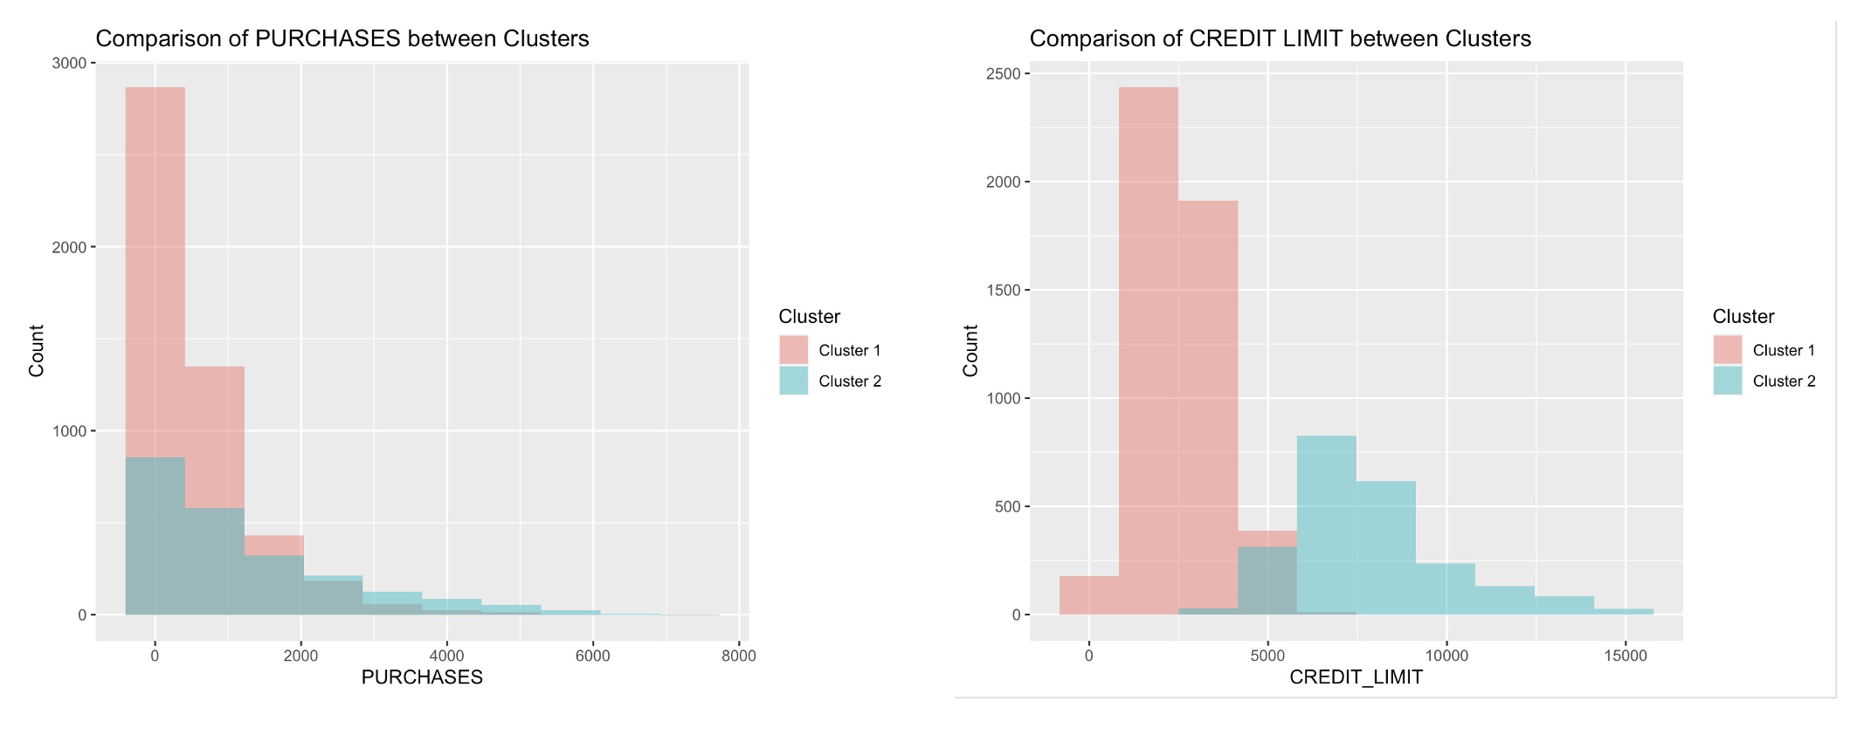
Customer Segmentation
Comparison between Clusters:

Slide 15
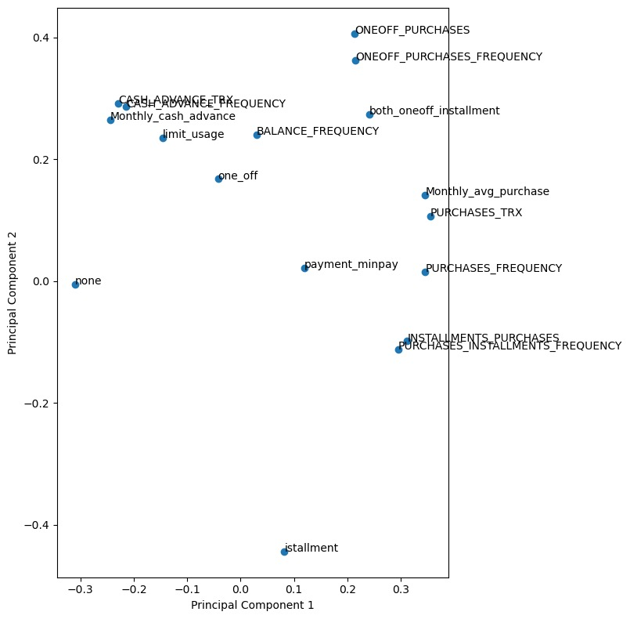
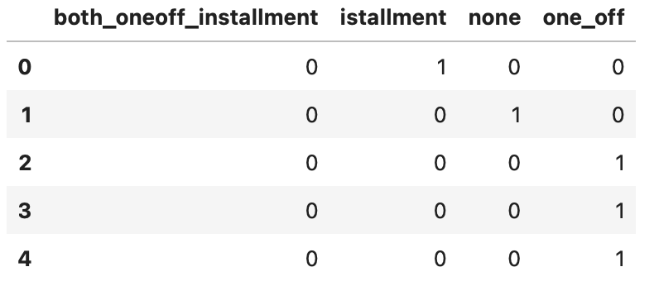
Customer Segmentation
Principal Component Analysis
Add Dummy Variables Result->

Slide 16
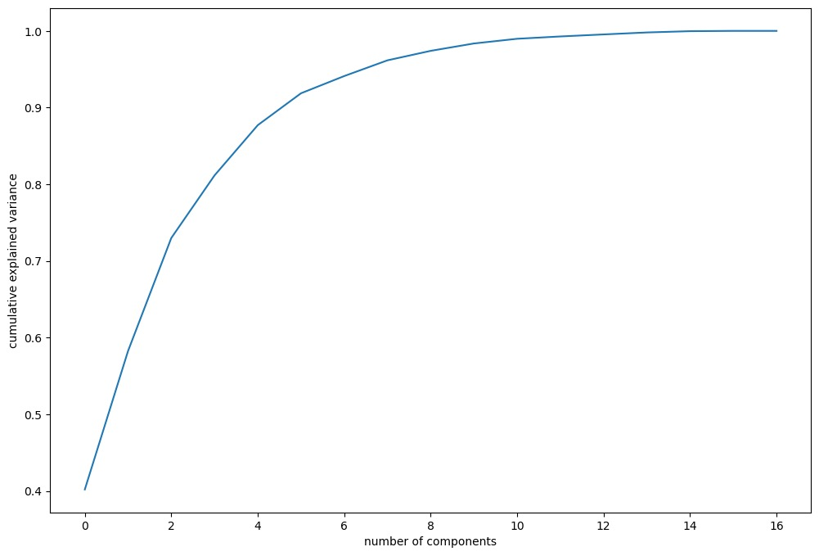
Customer Segmentation

Slide 17
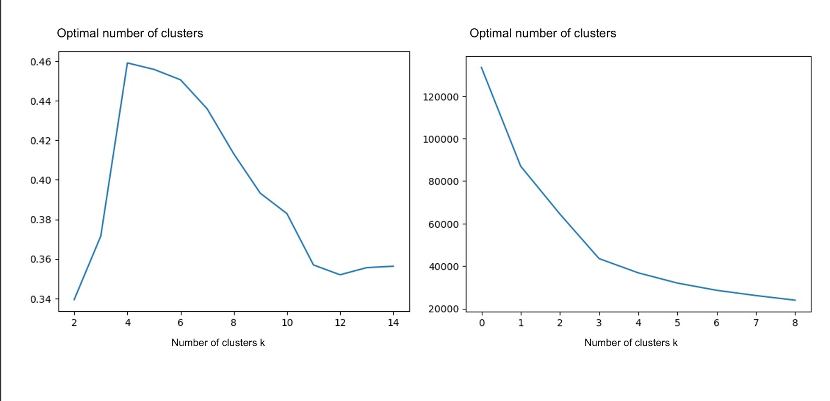
Customer Segmentation
Adjusted Clustering

Slide 18
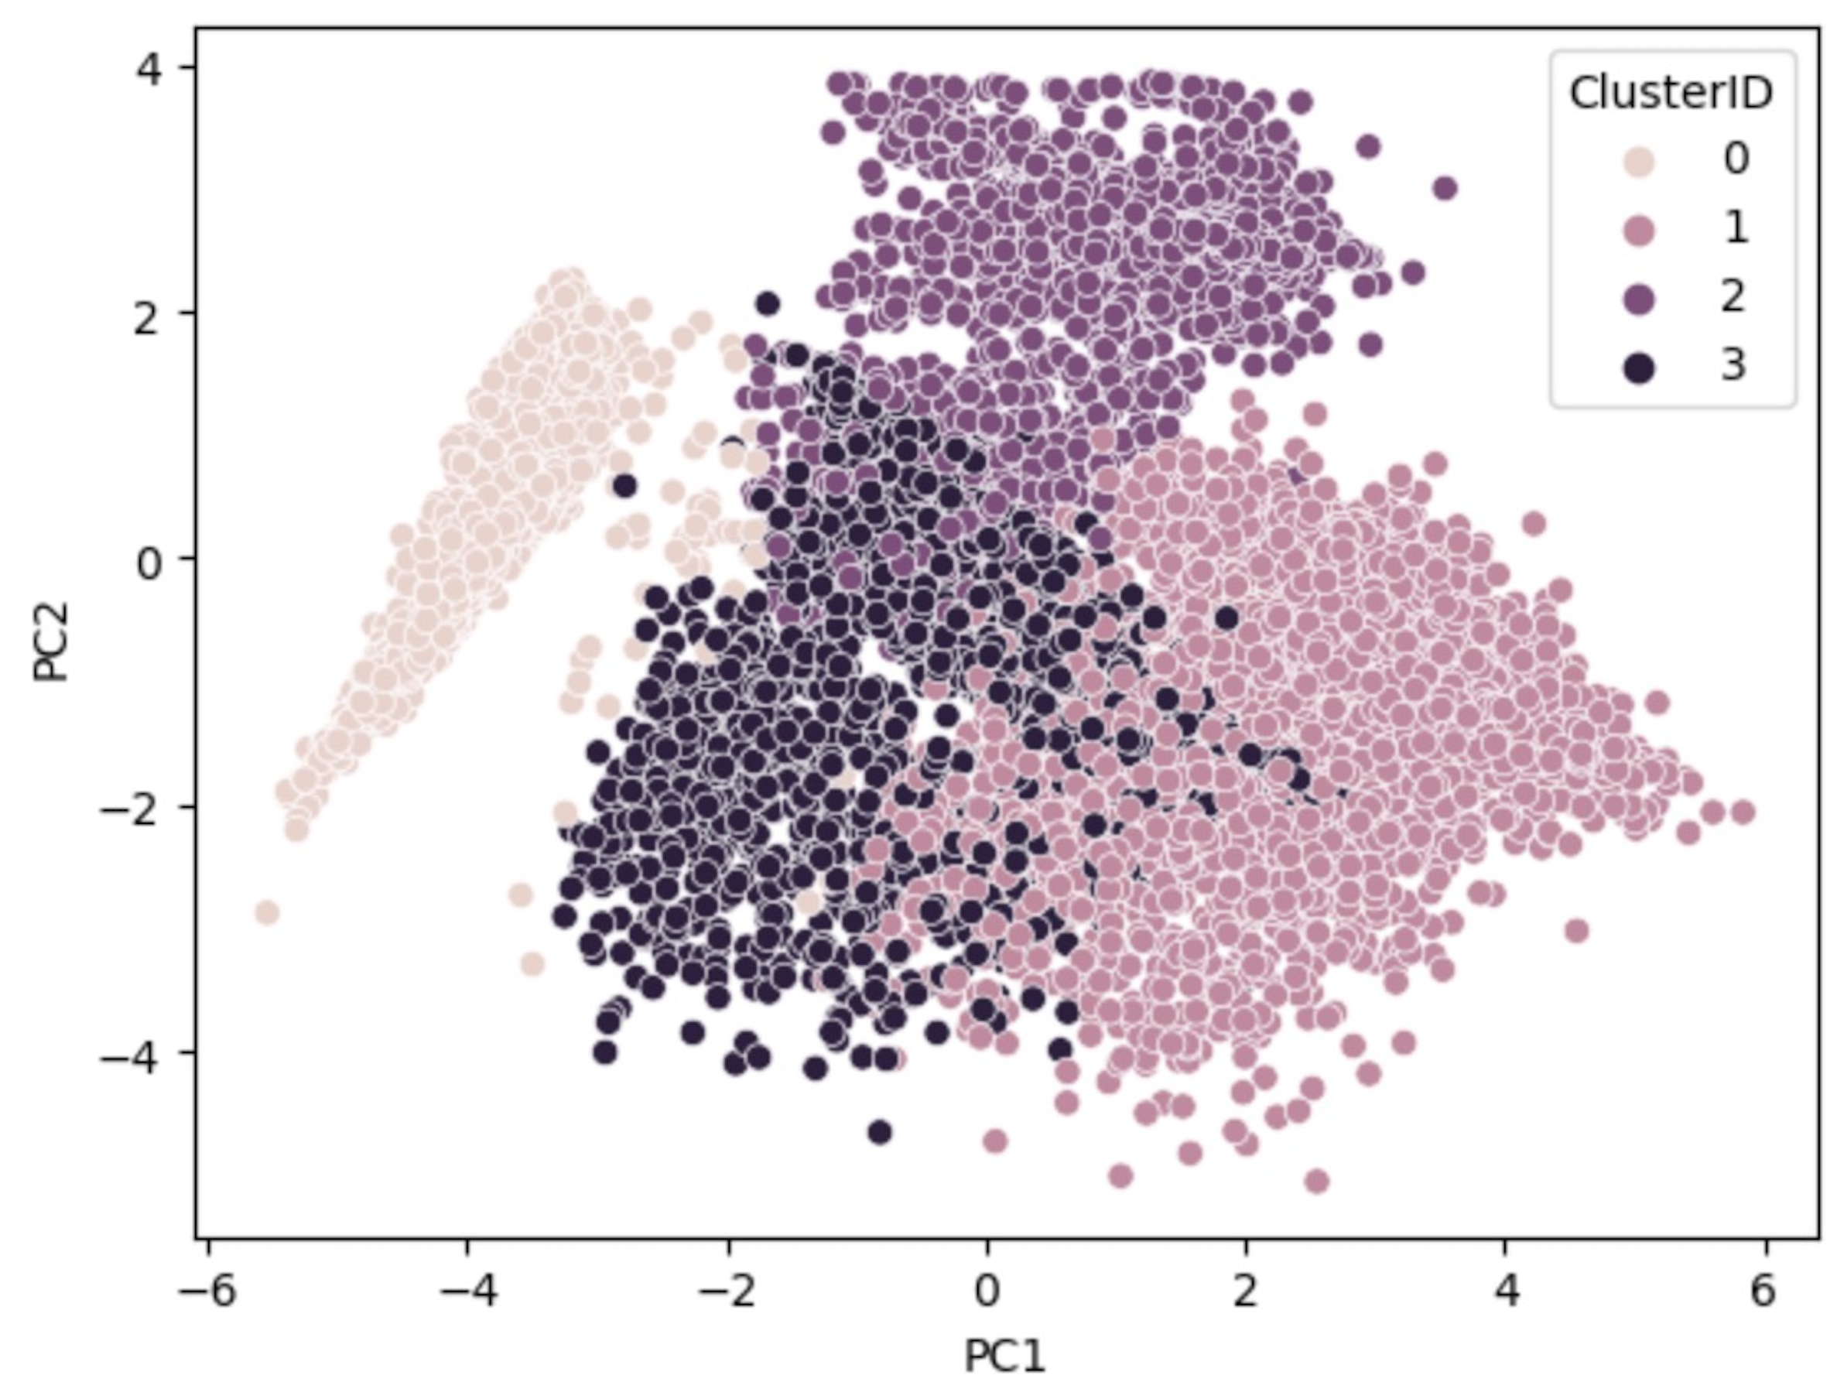
Customer Segmentation
Adjusted Clustering

Slide 19
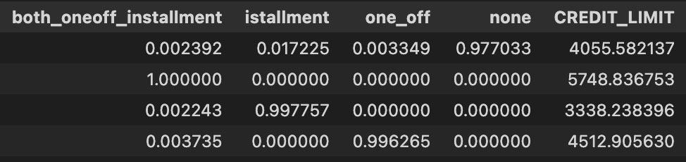
Customer Segmentation
Results Interpretation

Slide 20
03
Credit Limit Analysis

Slide 21
Credit Limit Analysis
Feature selection –> Distance Correlation
Detection of non-linear correlation
Insensitivity to scale and transformation
No assumption of data distribution
Statistical significance and interpretability

Slide 22
Credit Limit Analysis
Customer Clustering
5-most relevant columns
KMeans

Slide 23
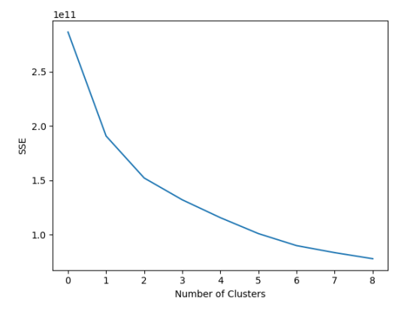
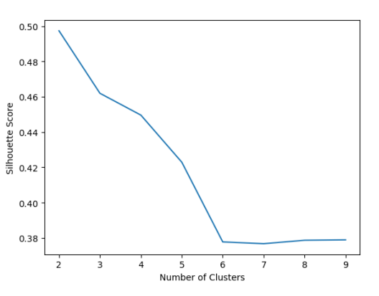
Credit Limit Analysis
Customer Clustering → k=3

Slide 24
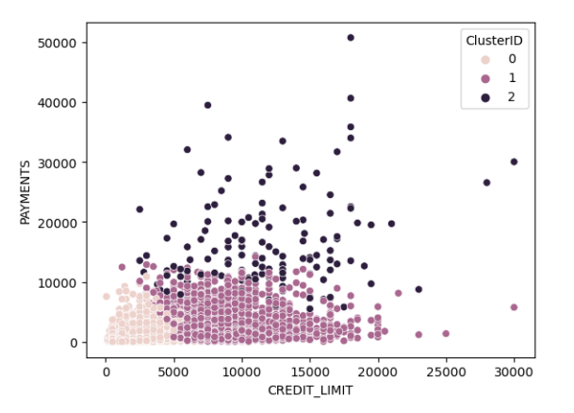
Credit Limit Analysis

Slide 25
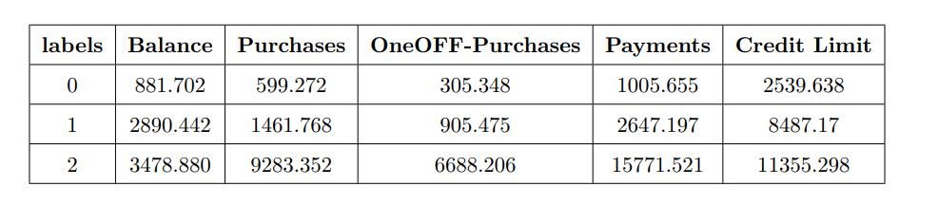
Credit Limit Analysis
Credit Division

Slide 26
Credit Limit Analysis
Random Forest Regression
→Predict credit limit!

Slide 27
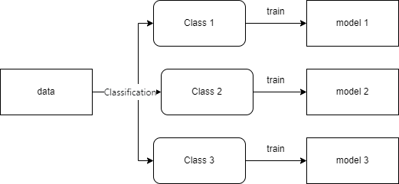
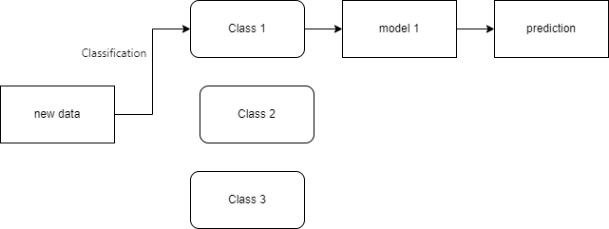
Credit Limit Analysis
Piecewise Random Forest Regression

Slide 28
Credit Limit Analysis
MSE: 0.5272→0.3916
Improve: 25.72%

Slide 29
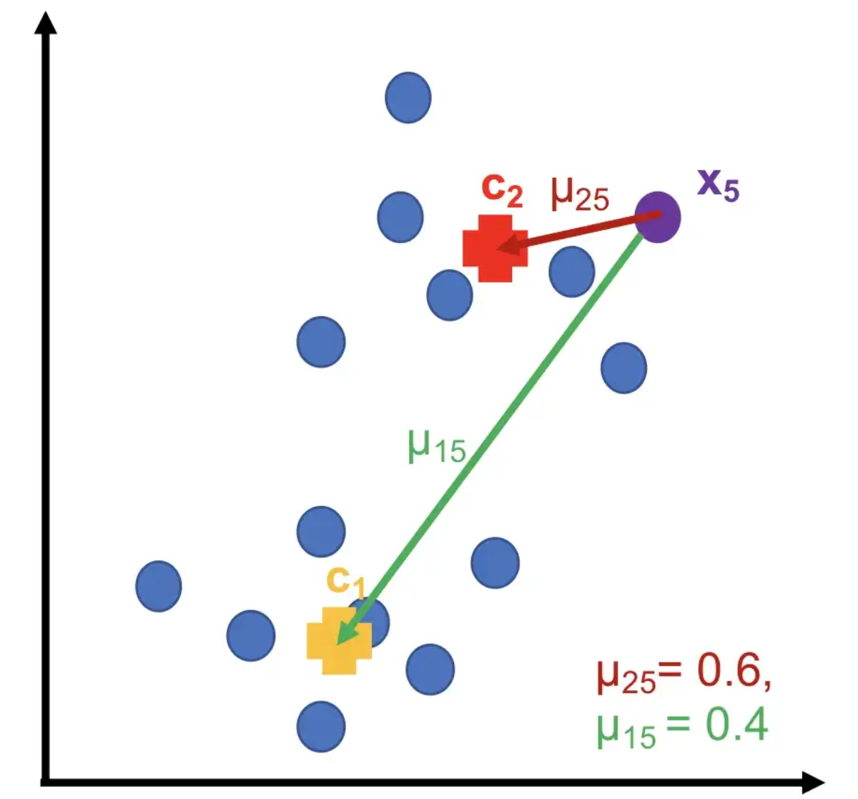
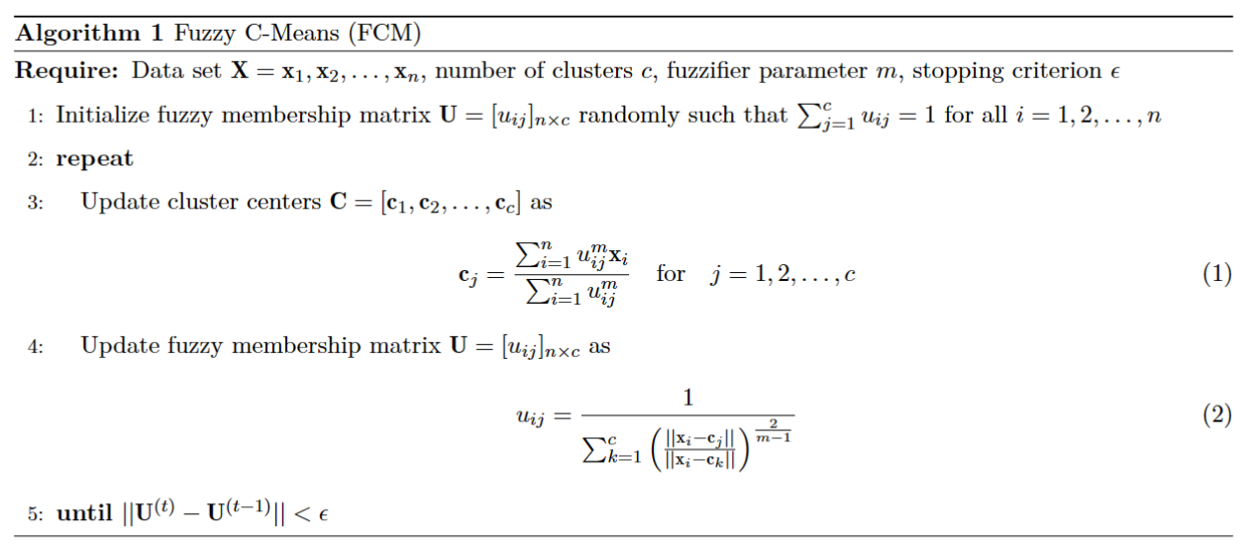
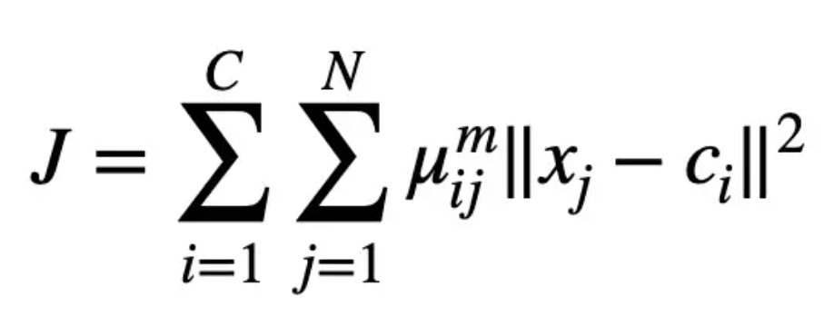
Fuzzy Clustering

Slide 30

Q&A
THANK YOU

